Slide 1
Introduction to Deep Learning (Neural Networks)
Day 3, Intro to Machine Learning
Caltech Library Workshop
Slides by Charles Guan
Notes:
Corresponding Google Colab Notebook link: https://colab.research.google.com/drive/1QyiqGfvaNBJKz0VoaiFhEpOAht0BMxxC?usp=sharing

Slide 2
Concepts we'll be using today
Classification
Train/validation/test and overfitting/underfitting
Python
Notes:
Covered regression and classification over the past 2 days
Will focus on classification, with the
Assume you've never heard of deep learning or neural networks before

Slide 3
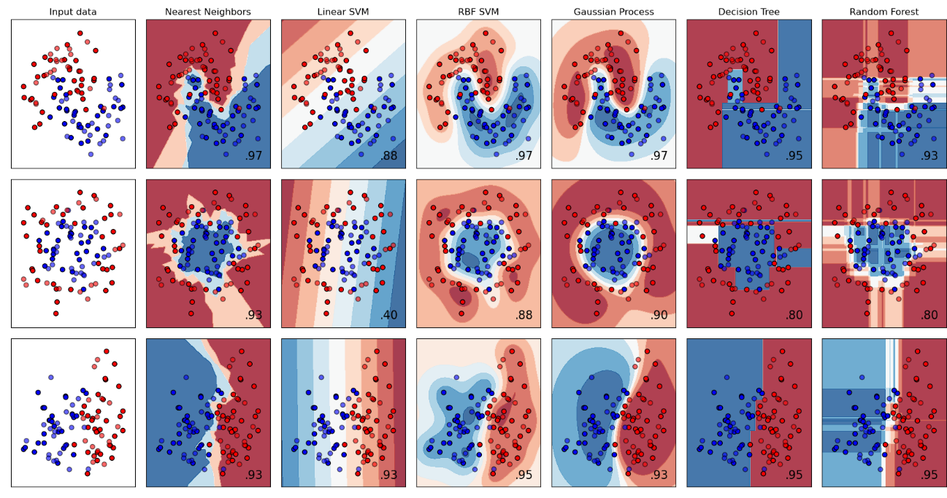
Machine learning (in this workshop) so far:
Notes:
Fairly straightforward boundaries
Different ways to trade off heuristics
This approach is nice. Pretty good if you can basically draw the lines yourself (in some high-D space)

Slide 4
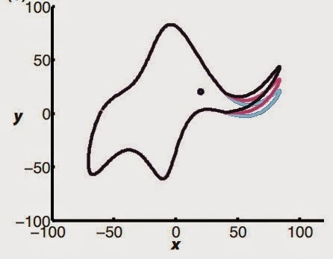
In favor of minimalism:
"with four parameters I can fit an elephant, with five I can make him wiggle his trunk" - von Neumann
http://wavefunction.fieldofscience.com/
What if we want to "fit" a real elephant? or all animals?

Slide 5
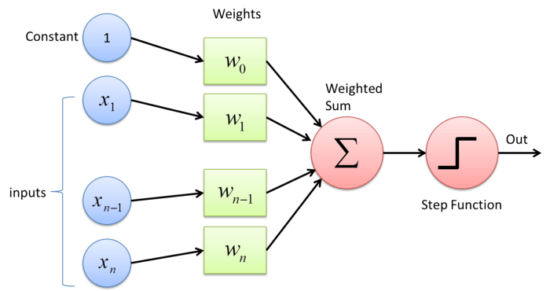
A maximalist approach to fitting models
More parameters
Our building block: "artificial" neuron
i.e., weighted sum with a nonlinearity
Apply these:
in parallel ("wide" networks)
sequentially ("deep" networks)

Slide 6

A maximalist approach to fitting models (cont.)
width
depth
Building block: "artificial neuron"
Reminder: goal of most machine learning = learn a "function" (inputs and outputs)
Use wide, deep networks can approximate any function you want.

Slide 7
A maximalist approach to fitting models (cont.)
Key idea: use more parameters to solve more difficult problems.
Iteratively tweak the parameters to fit the training data
Hope it generalizes to test data
Caveat: all the problems of overparameterization

Slide 8
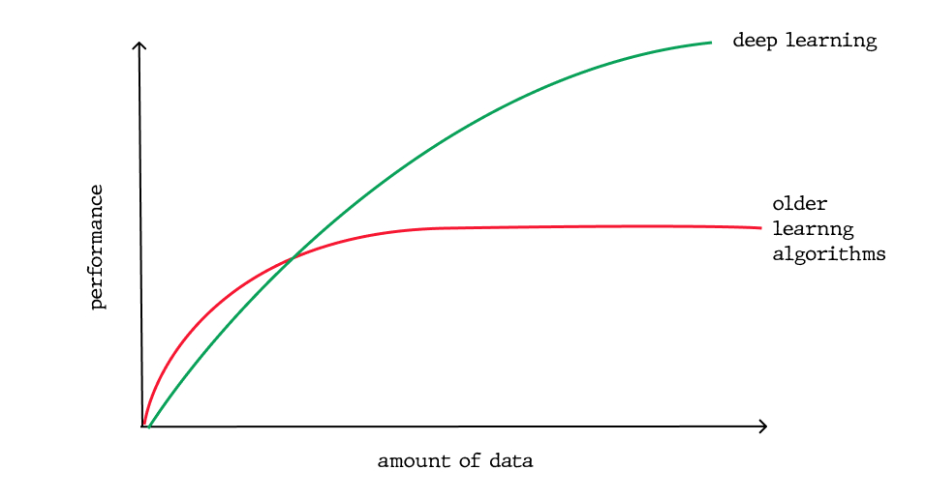
Neural Networks are good when...
humans can do it
you have a large dataset (10k - 1M+ independent samples)
you have lots of computational power (GPUs, TPUs)
https://soshace.com/deep-learning-vs-machine-learning-overview-comparison/

Slide 9
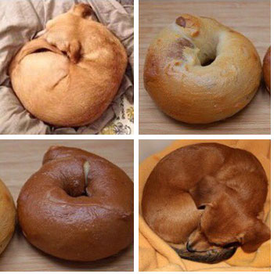
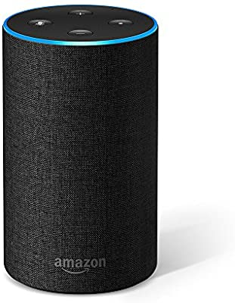
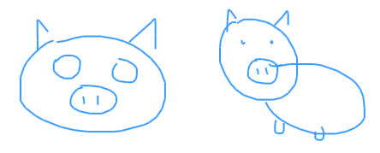
Example applications
humans can do it
lots of labeled data
(lots of compute power)
What's in each picture?
Are you talking to me?
Draw a cartoon pig!
Notes:
There are very light-hearted applications, but more serious ones as well.

Slide 10




Deep Learning Frameworks
What we'll use today
Notes:
Enough syntax to learn to fill a course, but I'm going to focus on standard example to walk you through the tools you might use yourself.

Slide 11
Let's code!
Time to open Google Colab again

Slide 12
Optimization: a visual

Slide 13
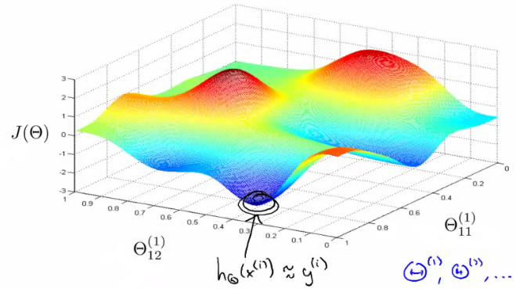
Cost function is not convex, but we try using gradient descent anyways

Slide 14
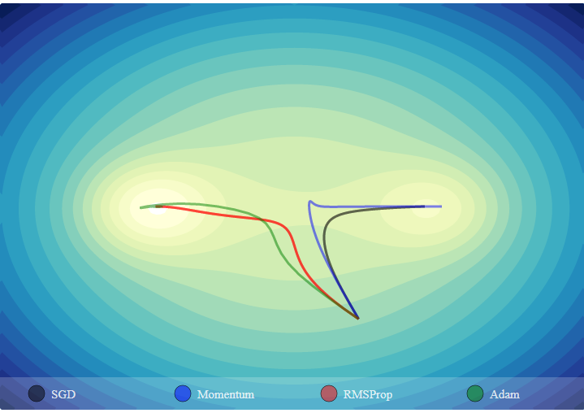
https://emiliendupont.github.io/2018/01/24/optimization-visualization/

Slide 15
Underfitting and overfitting

Slide 16
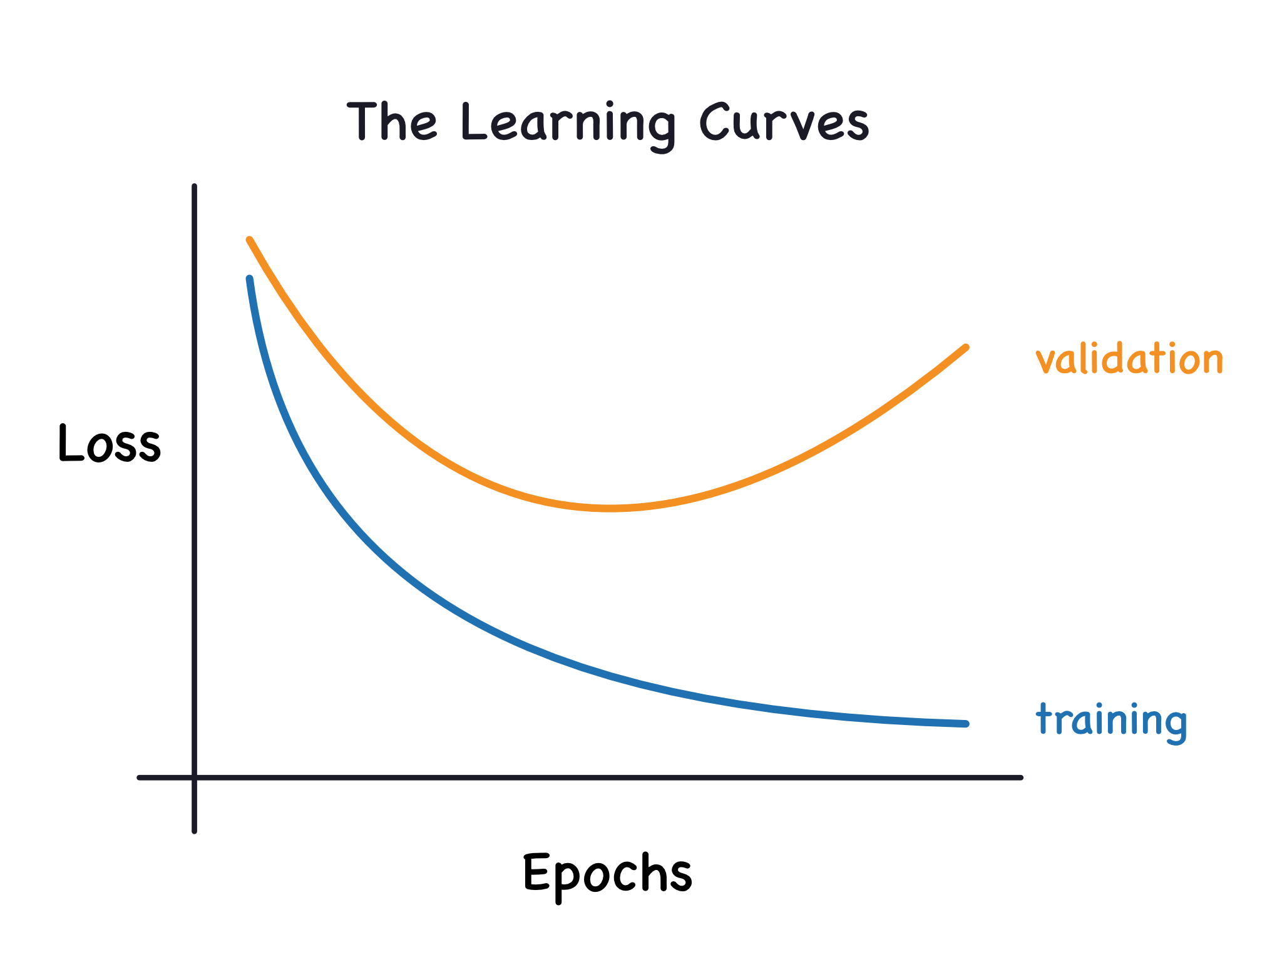
Training
https://www.kaggle.com/ryanholbrook/overfitting-and-underfitting

Slide 17

https://medium.com/greyatom/what-is-underfitting-and-overfitting-in-machine-learning-and-how-to-deal-with-it-6803a989c76

Slide 18
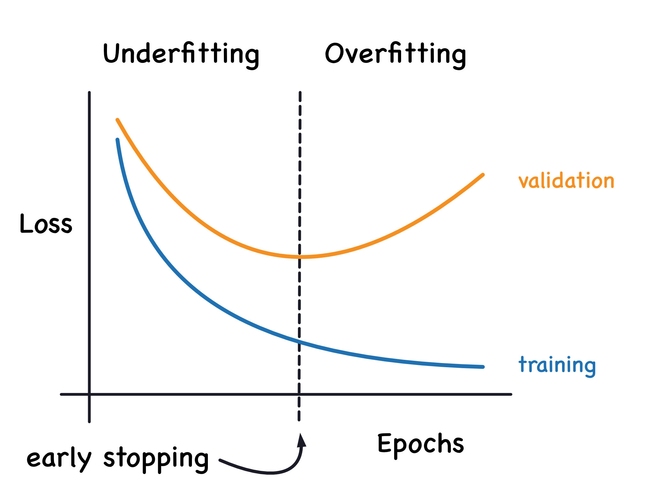
https://www.kaggle.com/ryanholbrook/overfitting-and-underfitting

